Slide 1
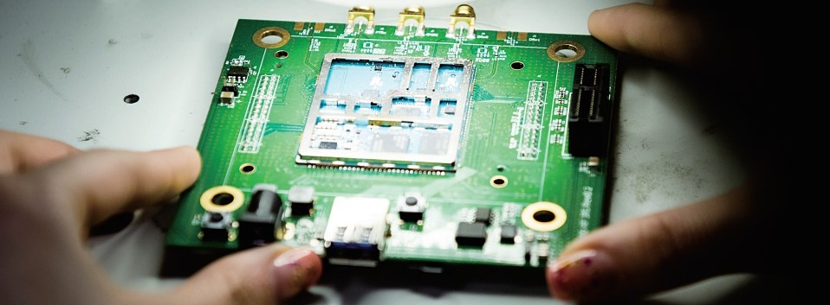
LG Innotek
Inno-step Project Presentation
LG Innotek 2020 하반기 채용 연계형 인턴십 과제 발표
개발 2팀 인턴 경서원

Slide 2

Project Goal
주
Goal : FA OS/TDR Board 제작
Test Board 해석
FA 실무 활용
Test Board
발주 / 검토
Image test / Bench test / OC test / IPQC / Up-Down test / DCR test / etc…
Failure Analysis
OS test / TDR test / IV curve / etc…
회로 Part 업무

Slide 3
Project Process
주
Step
02
Step
04
1. DESIGN - MODULE
Module Type FA Board Design
멘토님 지도 하에 22pin Pad 사용 OS/TDR 겸용 Board Design
3. BOARD Ordering
Order by Board Gerber File
Board 설계 수정, 실물 발주
5. FAILURE ANALYSIS
OS, TDR, IV curve, DCR test
Board를 활용한 FA 단계 직접 진행
2. DESIGN - CUBE
Cube Type FA Board Design
학습한 내용 바탕으로 36pin Pad Cube Socket 사용 OS/TDR 겸용 Board Design
4. SMT Pad, Socket
SMT, Soldering
Pad SMT, Switch/Socket/TDR pin soldering
Step
01
Step
03
Step
05

Slide 4
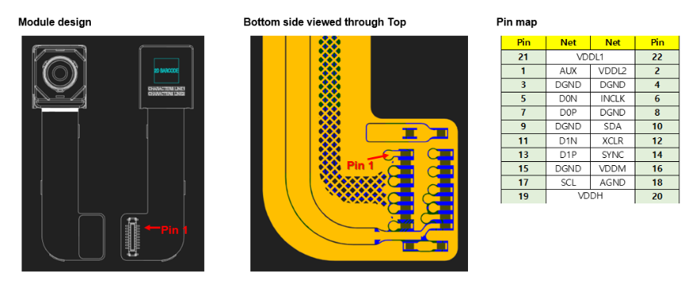
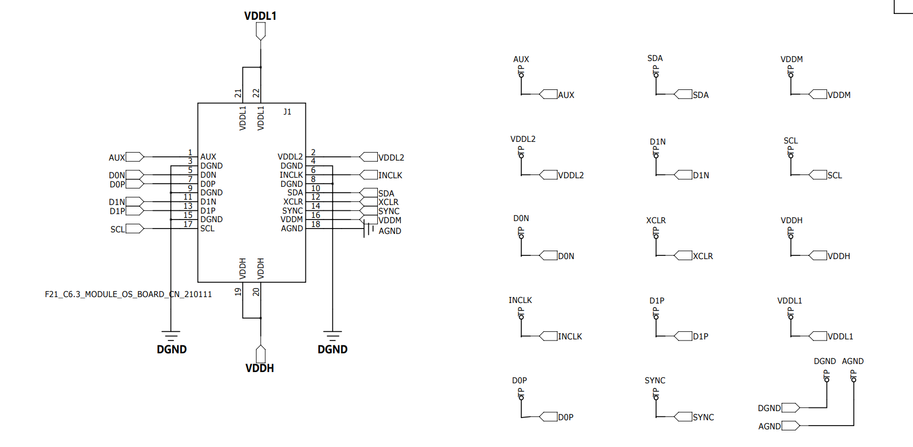
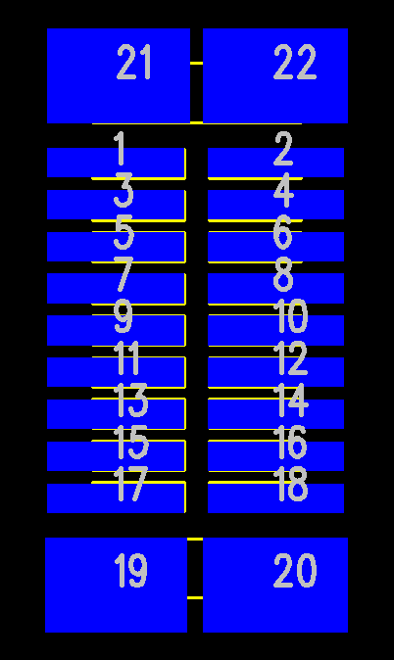
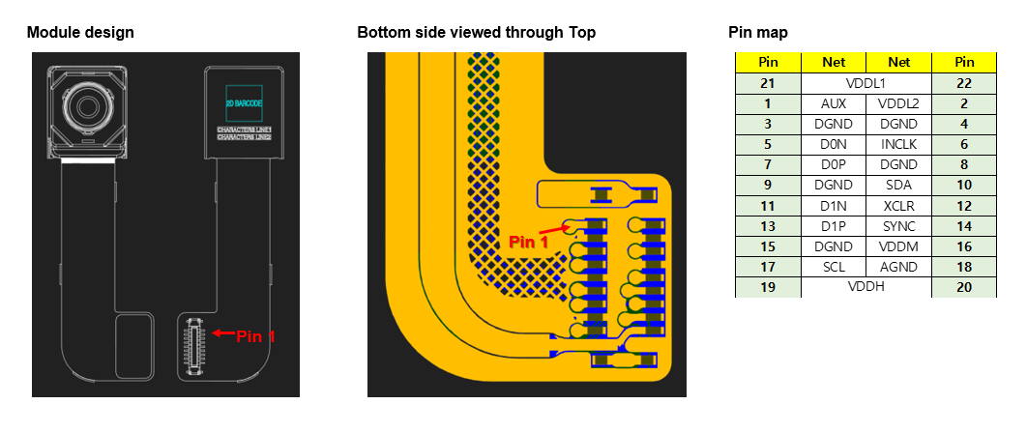
Step 1. Module type – Part design
주
01
02
03
Pin Spec
Schematic CAE Decal
PCB Decal

Slide 5
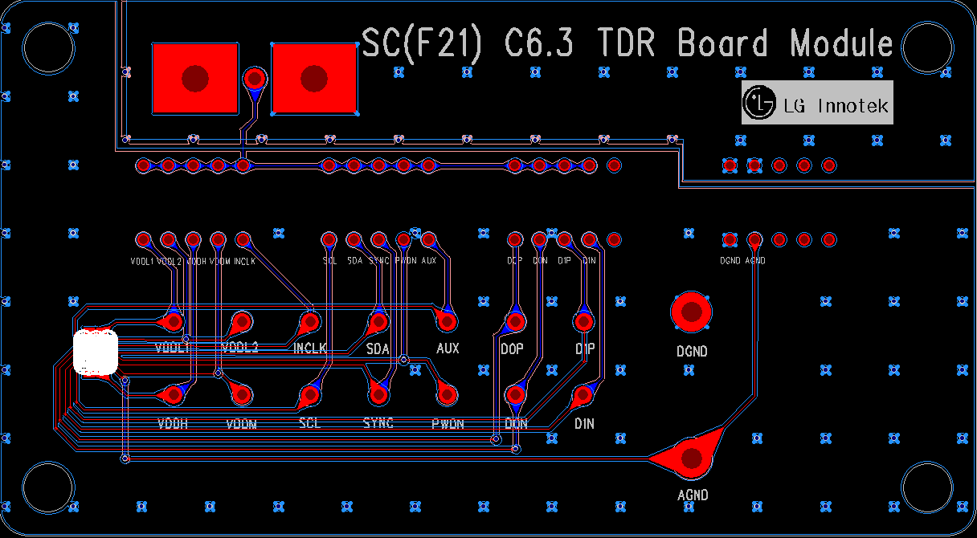

Step 1. Module type – Board design
주
Board Layout Design
TDR test pin
Switch
Schematic Design
OS test pin

Slide 6
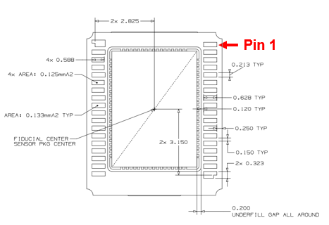
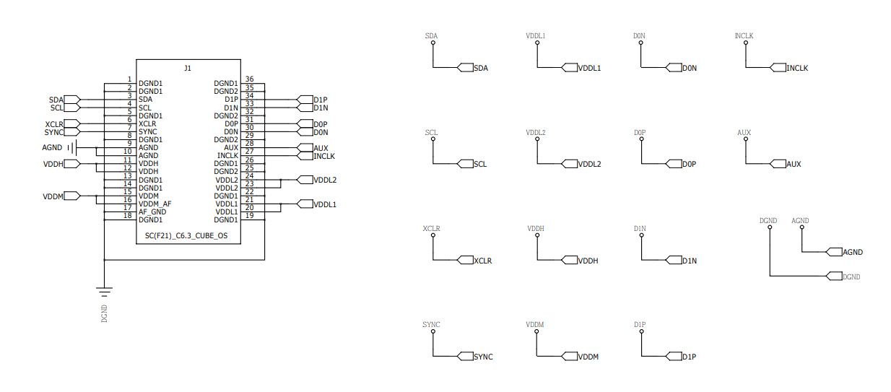
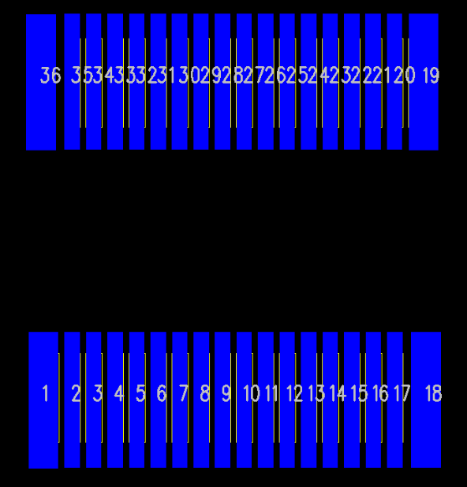
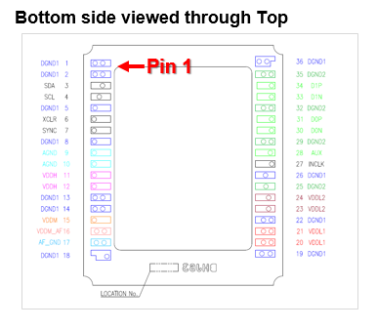
Step 2. Cube type – Part design
주
01
02
03
Pin Spec
Schematic CAE Decal
PCB Decal

Slide 7
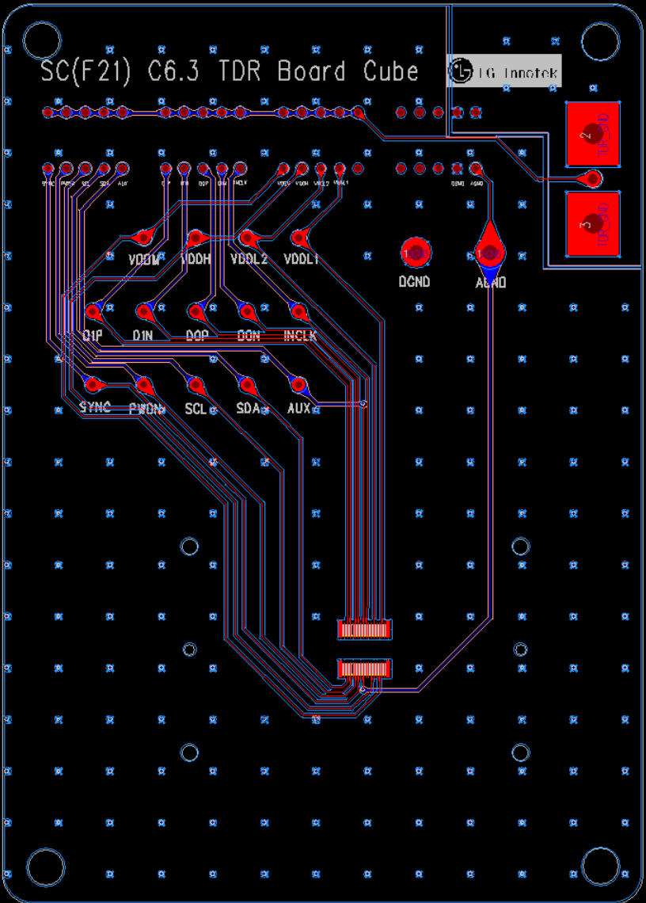
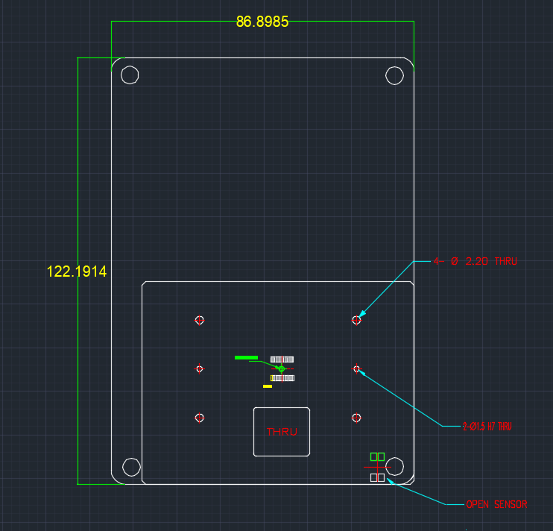
Step 2. Cube type – Board design
주
Schematic Design
Board Layout Design
Board Outline

Slide 8
Step 2. Cube type board - Discuss
주
DGND
TDR GND
TDR GND
AGND
DGND

Slide 9
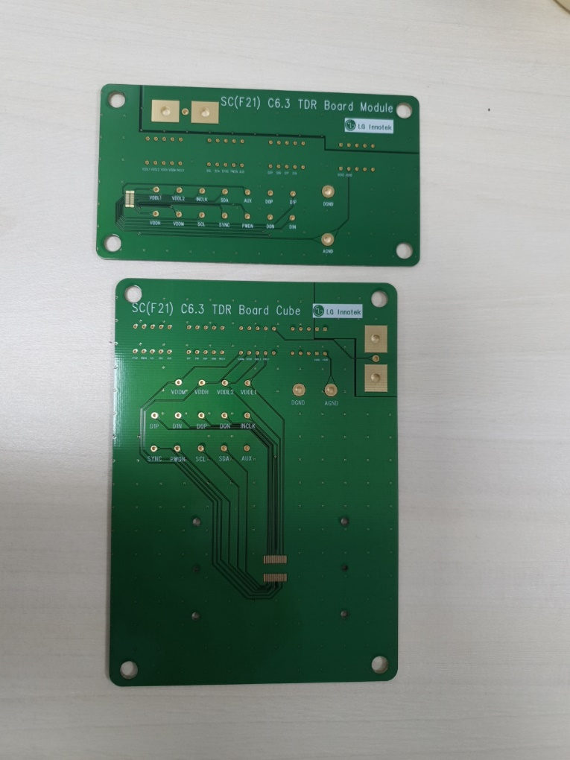
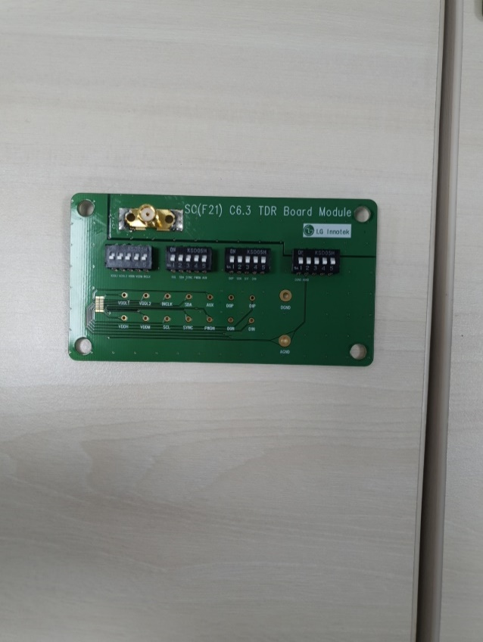
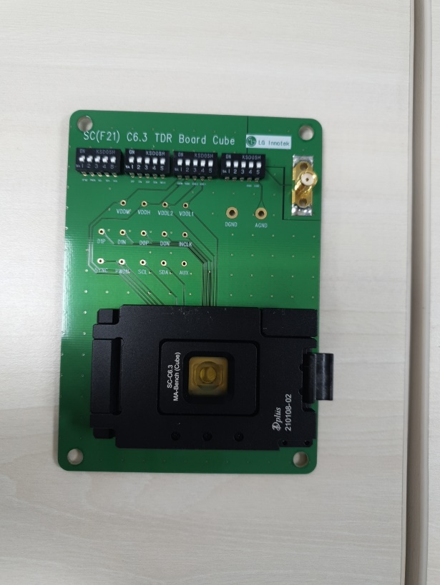
Step 3-4. Order Board, Soldering
주
Copper Pour 고려 수정
Board state
Soldered Board
Gerber File
Routing plan Top
Routing plan Bottom
Solder Mask Top
Solder Mask Bottom
Silkscreen Top
Drill
NC Drill
Switch
TDR test pin
Pin Test
pass
OS test pin
Socket space

Slide 10

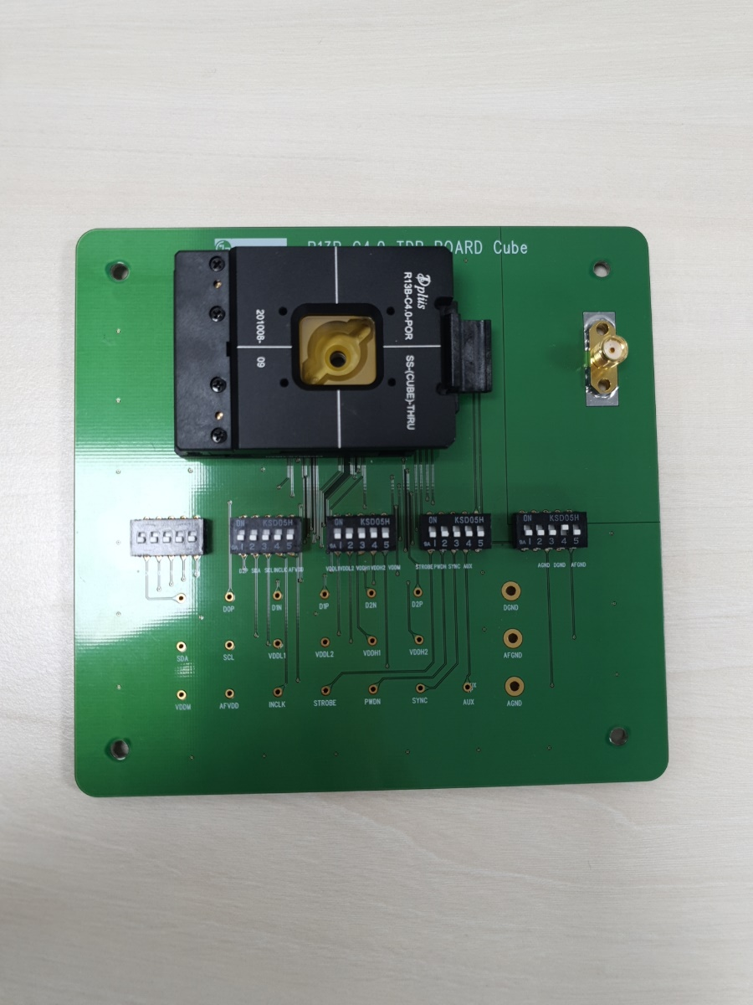
Step 5. Board 활용 Test, FA
주
SC Project Board
BE Project Board

Slide 11
Step 5. About FA
주
OS/TDR Board
Blemish
DCR
Module
Cube
Filter Ass’y
SFR
FA 유형
No Image
OS test
Reverse
Pin to Pin
Root Cause
Analysis
Cosmetic
VCM
TDR
I/V Curve
I/V Curve

Slide 12
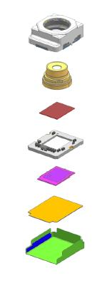
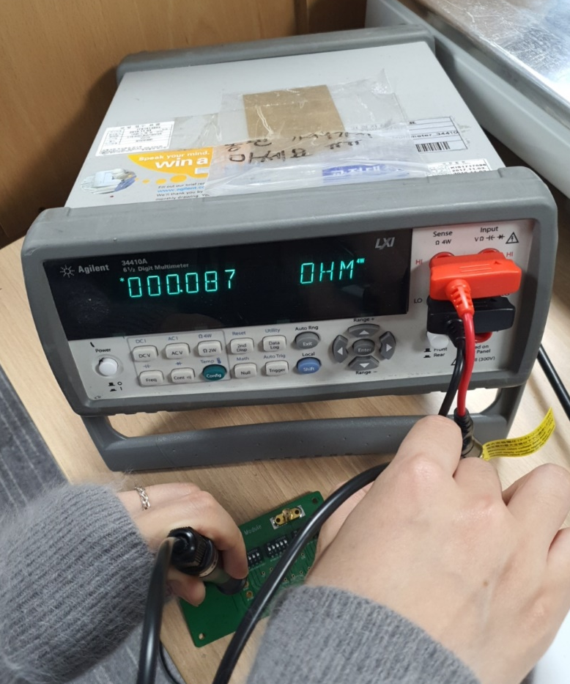
Step 5. DCR 측정
주
DCR test
- Top/GND , Top/Bottom
Top
VCM shield can
GND
FPCB
Stiffener
Bottom

Slide 13
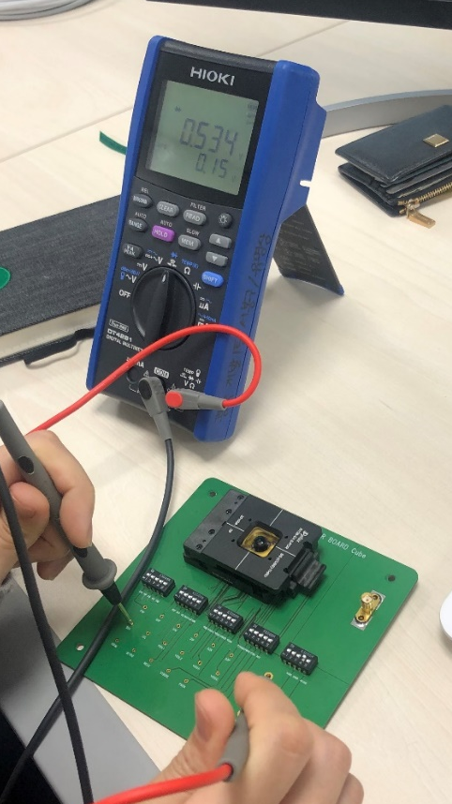
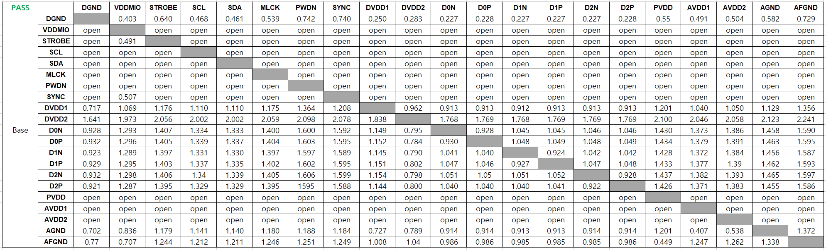
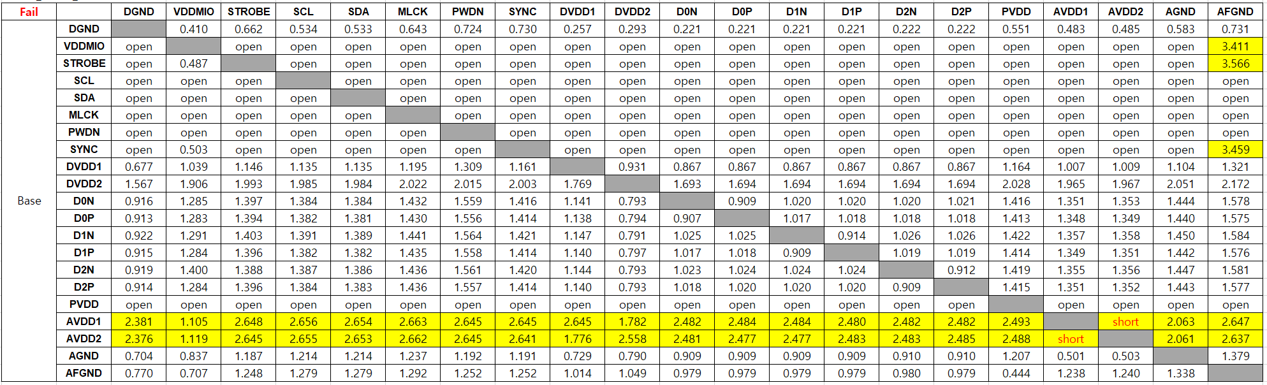
Step 5. FA – OS Test
No Image
주
Root Cause Analysis
OS Test result
Reverse OS Test
Pin-to-Pin Test
Config | C5053
Barcode No. | #256
Base : DGND | Pin. | Diode Voltage[V]
 |  | PASS sample | Sample 1
 | D0N | 0.199 | 0.190
 | D0P | 0.199 | 0.190
 | D1N | 0.199 | 0.189
 | D1P | 0.199 | 0.189
 | D2N | 0.192 | 0.184
 | D2P | 0.192 | 0.184
 | SDA | 0.467 | open
 | SCL | 0.467 | open
 | VDDL1 | 0.174 | short
 | VDDL2 | 0.275 | 0.218
 | VDDM | 0.417 | short
 | INCLK | 0.461 | 0.452
 | STROBE | 0.492 | open
 | PWDN | 0.487 | open
 | SYNC | 0.485 | open
 | AUX | 0.313 | 0.299
Base : AFGND | AFVDD | 0.455 | 0.450
Base : AGND | VDDH1 | 0.502 | open
 | VDDH2 | 0.529 | 0.505
Result |  |  | Fail
Config | C5053_HTHH_Sensor open
Barcode No. | #278
Base : DGND | Pin. | Diode Voltage[V] |  | Reverse Diode Voltage[V]
 |  | PASS sample | Sample 1 | PASS sample | Sample 1
 | D0N | 0.199 | 0.190 | open | open
 | D0P | 0.199 | 0.190 | open | open
 | D1N | 0.199 | 0.189 | open | open
 | D1P | 0.199 | 0.189 | open | open
 | D2N | 0.192 | 0.184 | open | open
 | D2P | 0.192 | 0.184 | open | open
 | SDA | 0.467 | 0.461 | 1.756 | 1.739
 | SCL | 0.467 | 0.461 | 0.678 | 0.674
 | VDDL1 | 0.174 | 0.170 | 1.530 | 1.567
 | VDDL2 | 0.275 | 0.218 | 0.916 | 0.915
 | VDDM | 0.417 | 0.412 | 0.919 | 0.913
 | INCLK | 0.461 | 0.452 | 0.915 | 0.921
 | STROBE | 0.492 | 0.481 | 0.914 | 0.914
 | PWDN | 0.487 | 0.480 | 0.911 | 0.919
 | SYNC | 0.485 | 0.472 | 0.915 | 0.914
 | AUX | 0.313 | 0.299 | open | open
Base : AFGND | AFVDD | 0.455 | 0.450 | open | open
Base : AGND | VDDH1 | 0.502 | 0.489 | open | 1.997
 | VDDH2 | 0.529 | 0.505 | open | 1.998
Result |  |  | pass | Result | Fail
[Example]

Slide 14
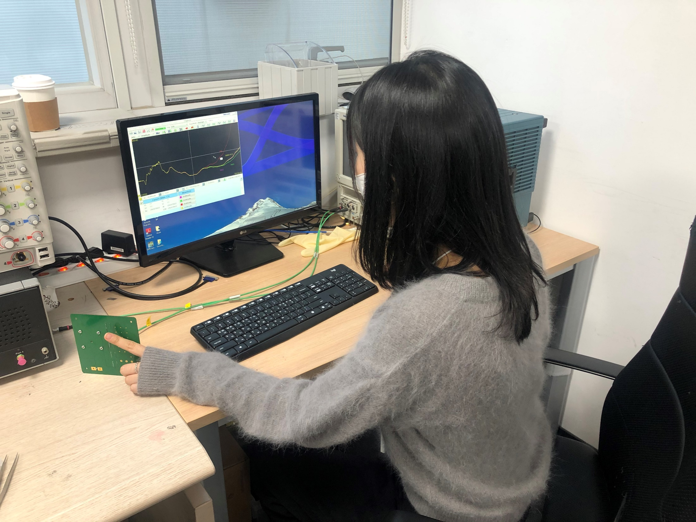
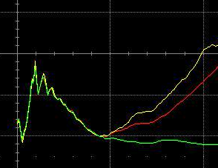
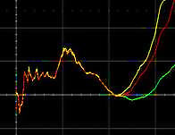
Step 5. FA – TDR Test
OS Test
주
TDR Test Graph
Point
VDDH1 | SCL
Bare HTCC
Bare HTCC
Pass sample
Pass sample
Fail sample
Fail sample

Slide 15
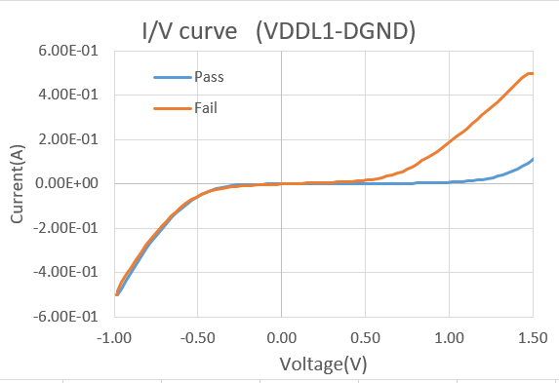
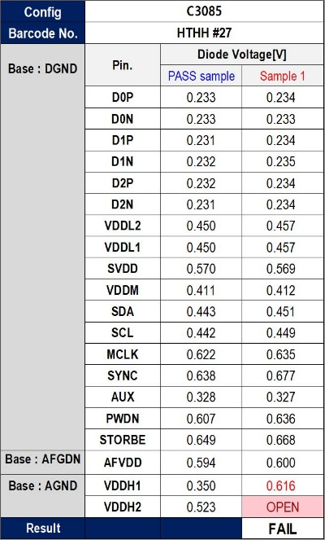
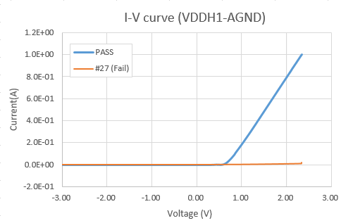
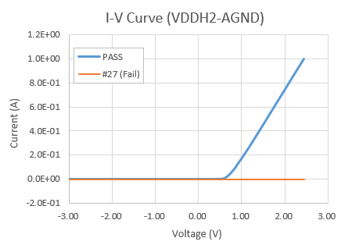
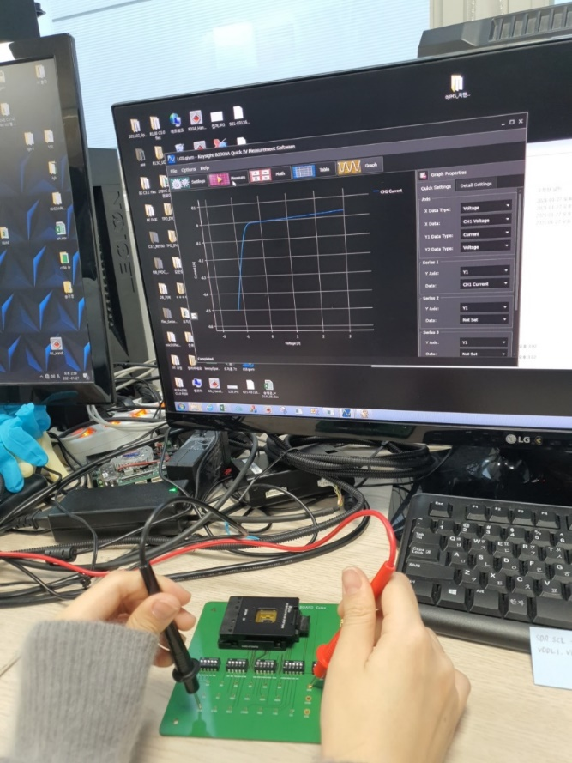
Step 5. FA – I/V Curve Test
OS Test
주
I/V Curve Graph
Short case
Open case
[Example]
Config | C5053
Barcode No. | #256
Base : DGND | Pin. | Diode Voltage[V]
 |  | PASS sample | Sample 1
 | D0N | 0.199 | 0.190
 | D0P | 0.199 | 0.190
 | D1N | 0.199 | 0.189
 | D1P | 0.199 | 0.189
 | D2N | 0.192 | 0.184
 | D2P | 0.192 | 0.184
 | SDA | 0.467 | open
 | SCL | 0.467 | open
 | VDDL1 | 0.174 | short
 | VDDL2 | 0.275 | 0.218
 | VDDM | 0.417 | short
 | INCLK | 0.461 | 0.452
 | STROBE | 0.492 | open
 | PWDN | 0.487 | open
 | SYNC | 0.485 | open
 | AUX | 0.313 | 0.299
Base : AFGND | AFVDD | 0.455 | 0.450
Base : AGND | VDDH1 | 0.502 | open
 | VDDH2 | 0.529 | 0.505
Result |  |  | Fail
Point

Slide 16
Project Conclusion
주
CM Module 구조
Line Test
Failure Analysis
Innotek
회사 생활
업무 중요점
Board 설계, 해석
Tool 사용 숙달
회로 업무 이해
실무 역량

Slide 17
감사합니다
개발 2팀 인턴 경서원

